Slide 1
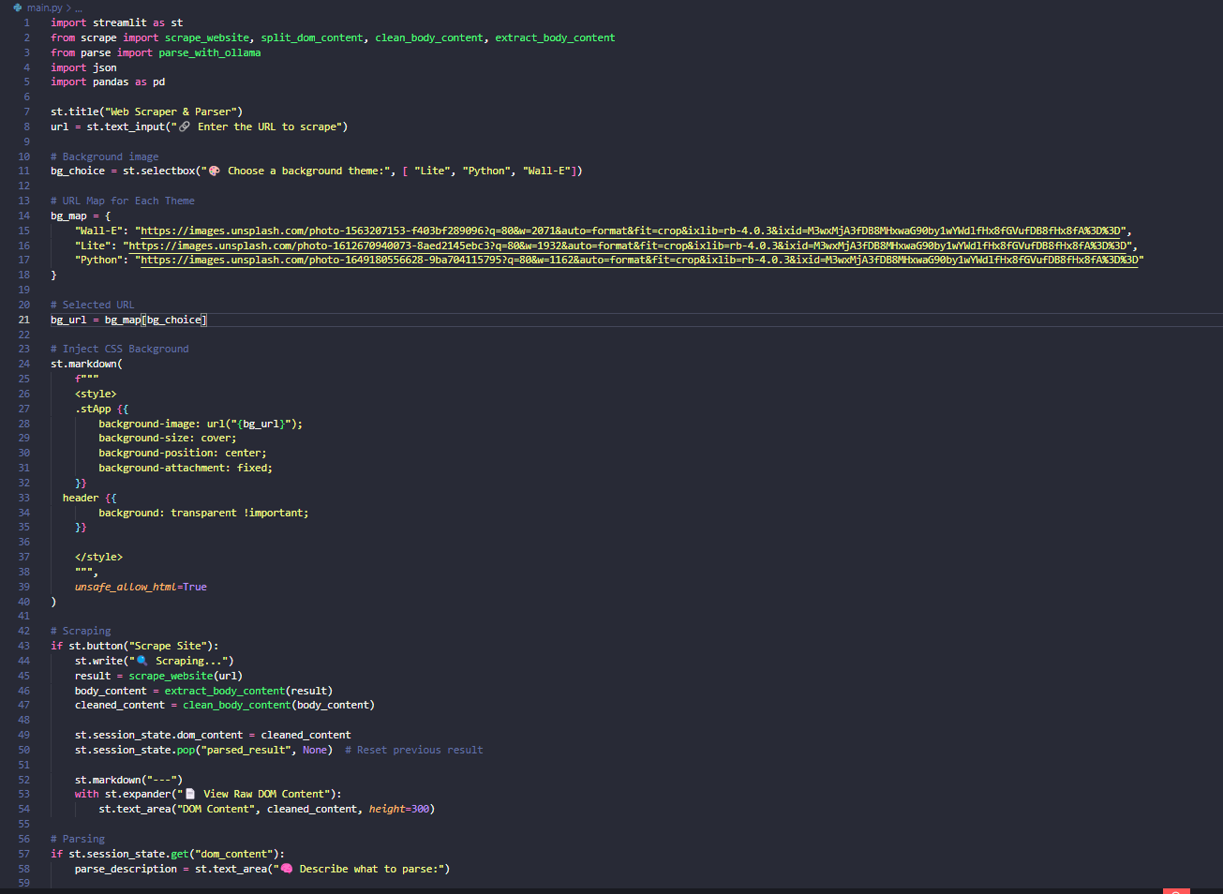
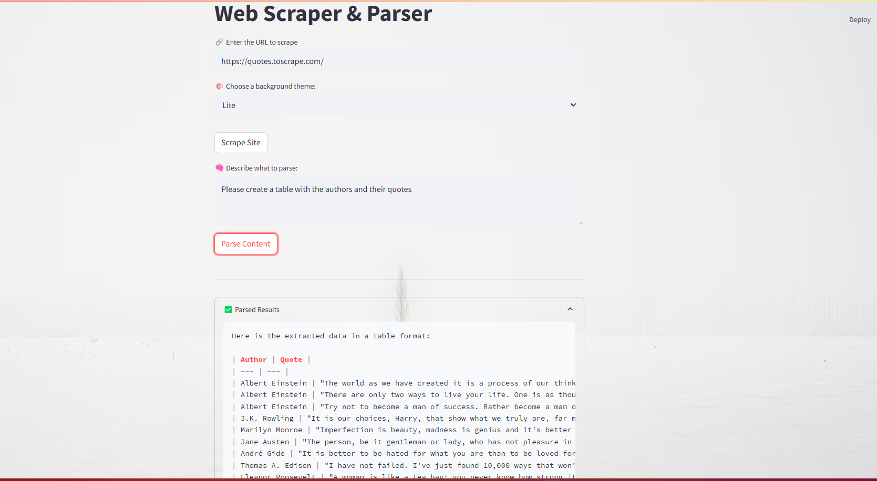
Web Scraper for APP DEV
Data Extraction with AI-Powered Parsing
Danis Kennedy
https://github.com/ksu-is/Web-Scraper
This Web Scraper is a Stream-lit application that scrapes HTML content from a website, then uses Ollama to parse the information you need based on your custom instructions. It also offers selectable background themes, a raw‑DOM viewer, and the ability to download the parsed results in both JSON and CSV formats.

